Slide 1

Peggy Ryan Williams Center
AE Senior Thesis
April 14, 2014
Angela Mincemoyer
Structural Option
Advisor | Dr. Boothby
Ithaca, New York

Slide 2
Peggy Ryan Williams Center
Introduction
Proposal
Structural Depth
  Gravity System
  Lateral System
  Bridge Truss
Architectural Breadth
Lighting Breadth
Conclusion
AE Senior Thesis
April 14, 2014
Angela Mincemoyer
Structural Option
Advisor | Dr. Boothby
Ithaca, New York

Slide 3
Peggy Ryan Williams Center
Introduction
Proposal
Structural Depth
  Gravity System
  Lateral System
  Bridge Truss
Architectural Breadth
Lighting Breadth
Conclusion
Owner | Ithaca College
Architect | Holt Architects
Structural Engineer | Ryan-Biggs Associates
58,200 GSF
4 Stories
Substantial Completion | March 2010
Photo provided courtesy of Holt Architects
Introduction

Slide 4
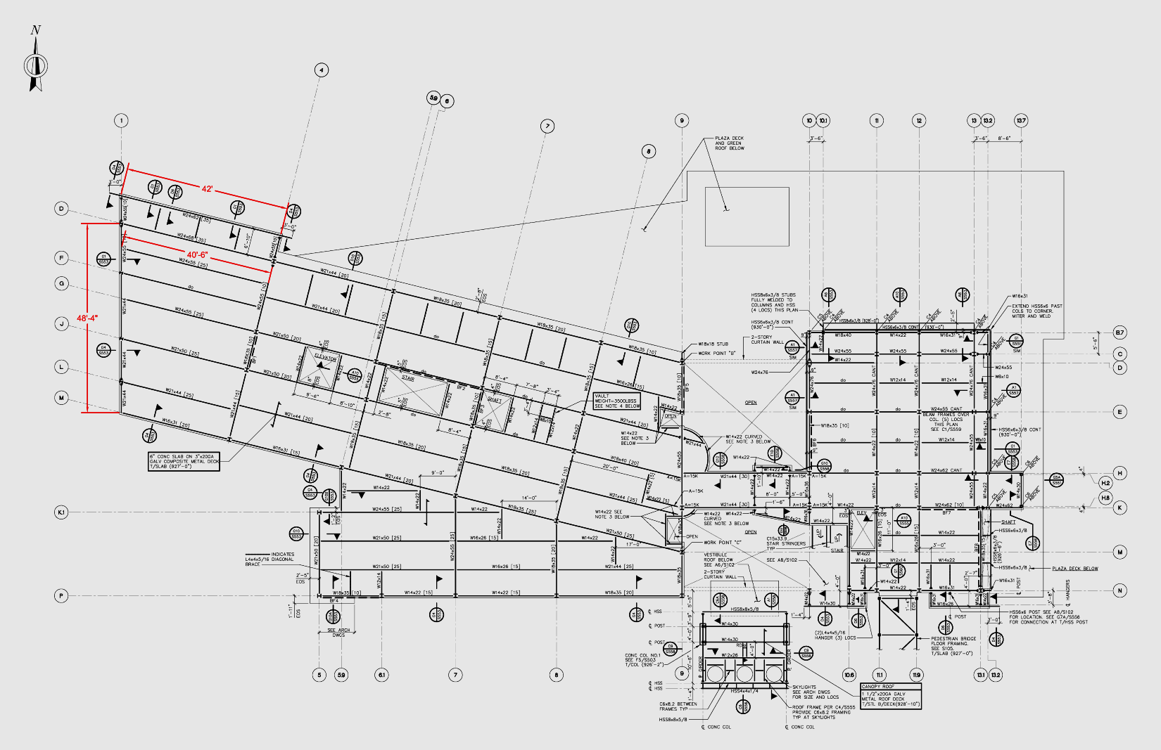
Peggy Ryan Williams Center
Introduction
Proposal
Structural Depth
  Gravity System
  Lateral System
  Bridge Truss
Architectural Breadth
Lighting Breadth
Conclusion
Composite steel floor
3” x 20 gauge composite metal deck
6” concrete slab
Wide Flange
Beams, girder, columns
Irregular Layout
Geometry, cantilevers
42’
48’
Existing Gravity System

Slide 5
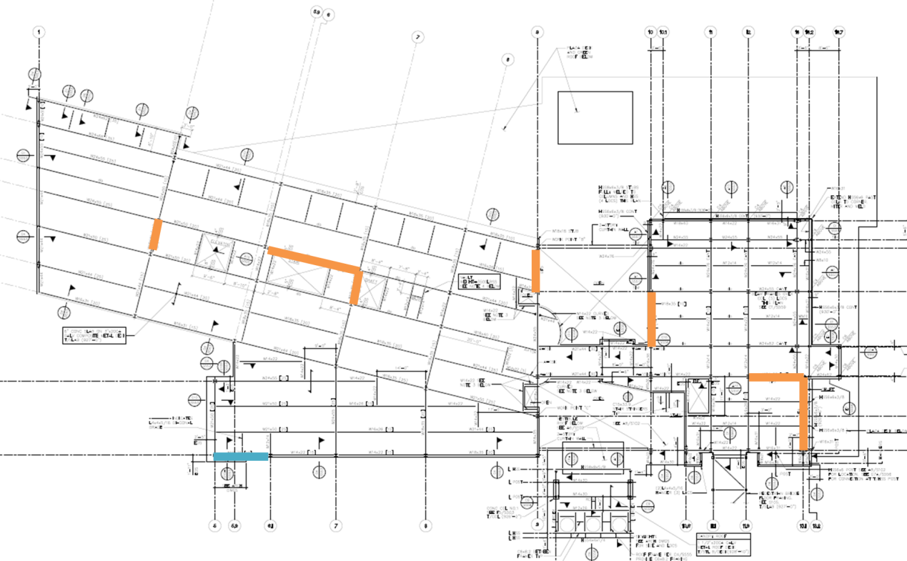

Peggy Ryan Williams Center
Introduction
Proposal
Structural Depth
  Gravity System
  Lateral System
  Bridge Truss
Architectural Breadth
Lighting Breadth
Conclusion
Concentrically braced structural steel frames
North-South
East-West
Seismic Design Category A
Wind Controlled Design
Existing Lateral System

Slide 6
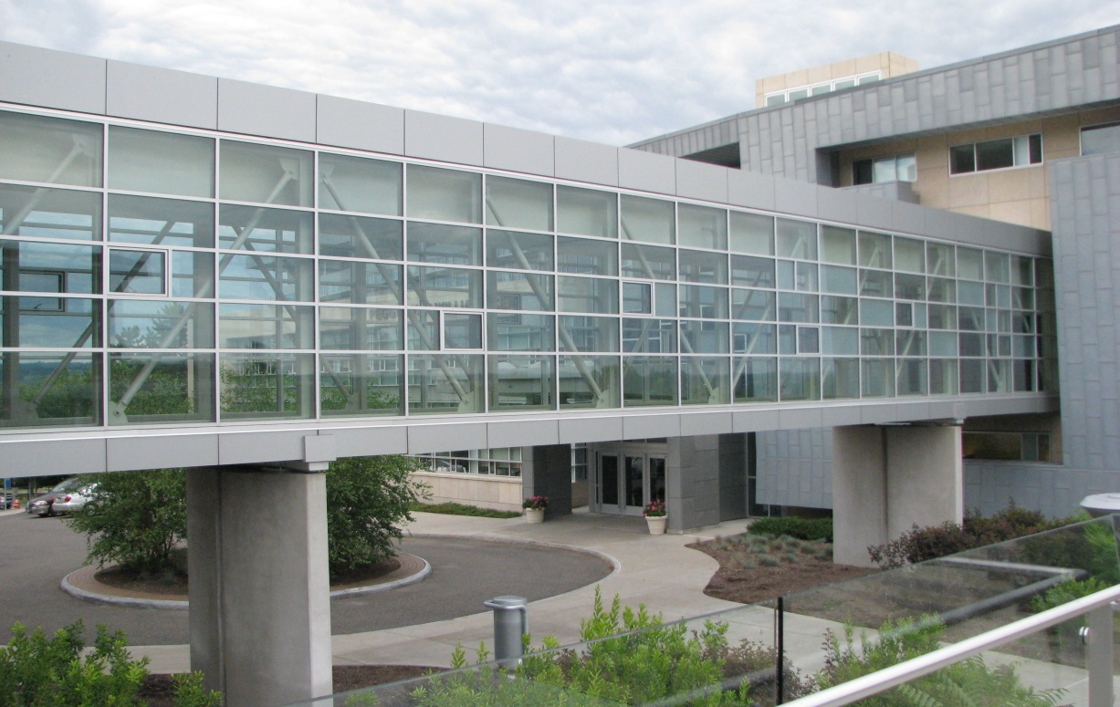
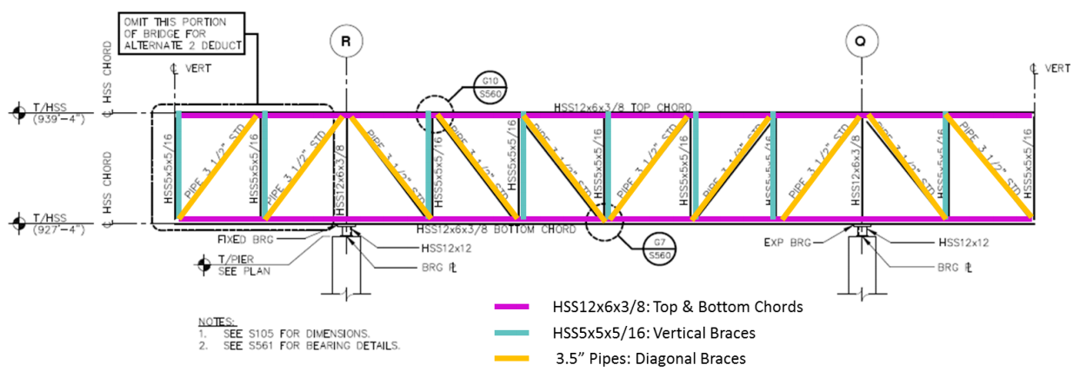
Peggy Ryan Williams Center
Introduction
Proposal
Structural Depth
  Gravity System
  Lateral System
  Bridge Truss
Architectural Breadth
Lighting Breadth
Conclusion
Pratt Trusses
HSS
3.5” pipe
Double Cantilever
Existing Bridge System

Slide 7
Peggy Ryan Williams Center
Scenario | Project Schedule is no longer critical
Proposal | One way concrete slab system with pan joists and girders
          Beneficial for cantilevers
          Accommodates varying spans & geometries
          Thinner slab
          Minimize architectural impact
Scenario | Learning opportunity
Proposal | Two different redesign options will be considered
          Reflection of New York’s historic covered bridges
          Reflect on original name of the building
          (“The Gateway Building”)
Introduction
Proposal
Structural Depth
  Gravity System
  Lateral System
  Bridge Truss
Architectural Breadth
Lighting Breadth
Conclusion
Building
Bridge

Slide 8
Peggy Ryan Williams Center
Scenario | Project Schedule is no longer critical
Proposal | One way concrete slab system with pan joists and girders
          Beneficial for cantilevers
          Accommodates varying spans & geometries
          Thinner slab
          Minimize architectural impact
Scenario | Learning opportunity
Proposal | Two different redesign options will be considered
          Reflection of New York’s historic covered bridges
          Reflect on original name of the building
          (“The Gateway Building”)
Introduction
Proposal
Structural Depth
  Gravity System
  Lateral System
  Bridge Truss
Architectural Breadth
Lighting Breadth
Conclusion
Building
Bridge

Slide 9
Peggy Ryan Williams Center
Proposal| One way concrete slab system with pan joists and girders
Goals| Design a one way concrete slab system while:
          Minimizing floor system depth
          Minimizing architectural impact
Proposal| Two different redesign options will be considered
Goals| After considering two redesign options:
          Determine which option to move forward with
          Design one side truss of the bridge
Introduction
Proposal
Structural Depth
  Gravity System
  Lateral System
  Bridge Truss
Architectural Breadth
Lighting Breadth
Conclusion
Building
Bridge

Slide 10
Peggy Ryan Williams Center
Proposal| One way concrete slab system with pan joists and girders
Goals| Design a one way concrete slab system while:
          Minimizing floor system depth
          Minimizing architectural impact
Proposal| Two different redesign options will be considered
Goals| After considering two redesign options:
          Determine which option to move forward with
          Design one side truss of the bridge
Introduction
Proposal
Structural Depth
  Gravity System
  Lateral System
  Bridge Truss
Architectural Breadth
Lighting Breadth
Conclusion
Building
Bridge

Slide 11
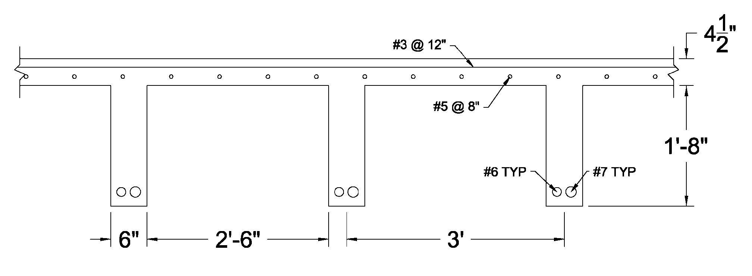
Peggy Ryan Williams Center
Introduction
Proposal
Structural Depth
  Gravity System
  Lateral System
  Bridge Truss
Architectural Breadth
Lighting Breadth
Conclusion
  CRSI Manual
  Same joist size and spacing used throughout
  2 worst case spans considered
  30” forms with 6” rib @ 36” o.c.
  20” rib depth + 4.5” slab = 24.5” system depth
  f’c = 4,000 psi
  fy = 60 ksi
Pan Joist System

Slide 12
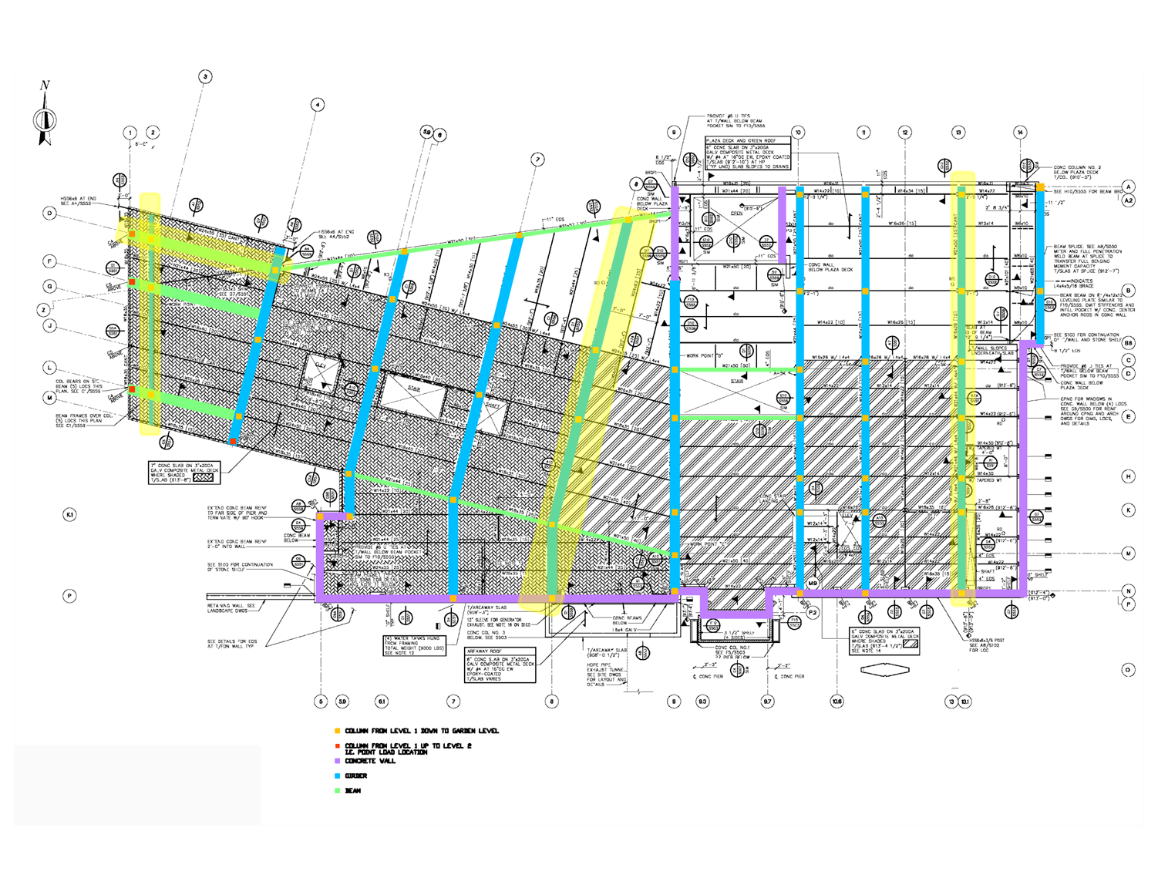
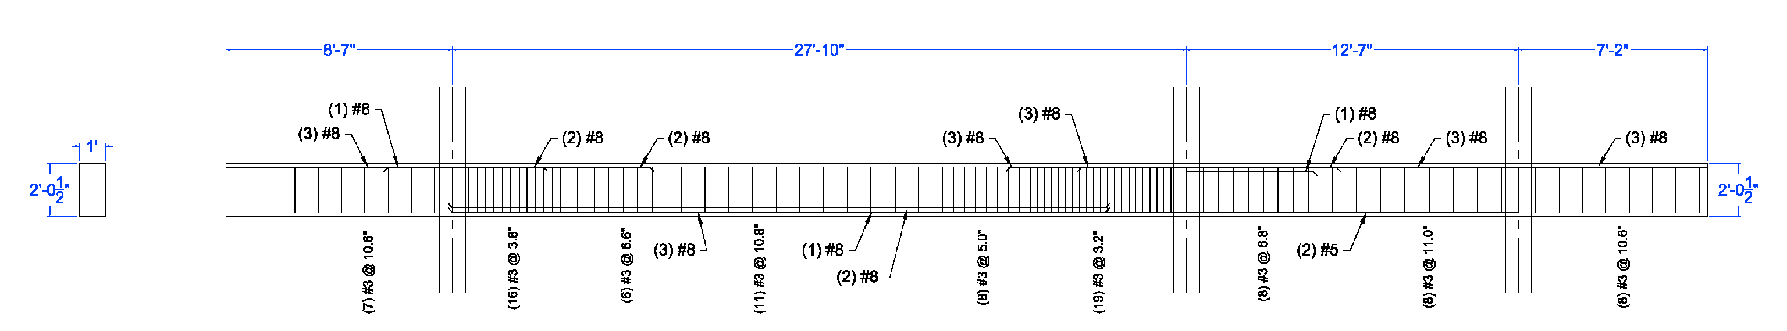
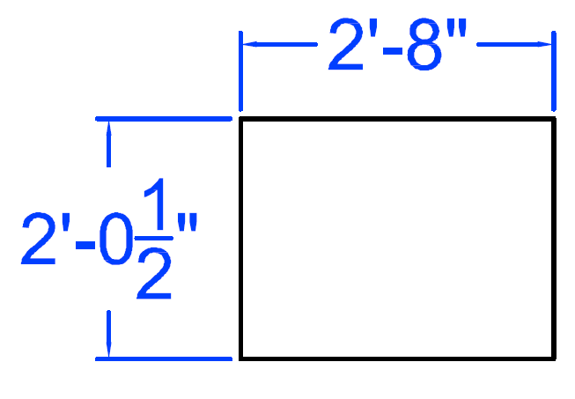
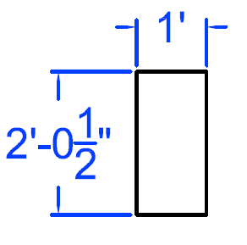
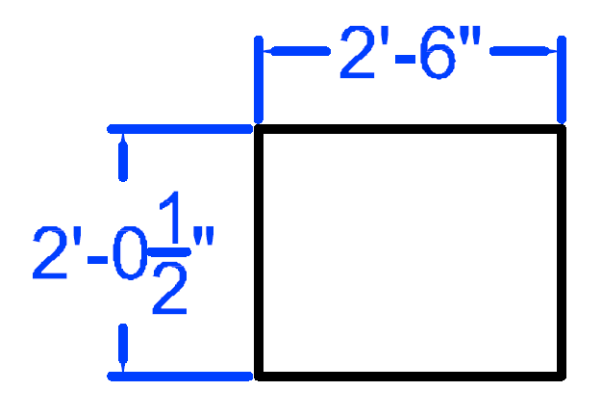
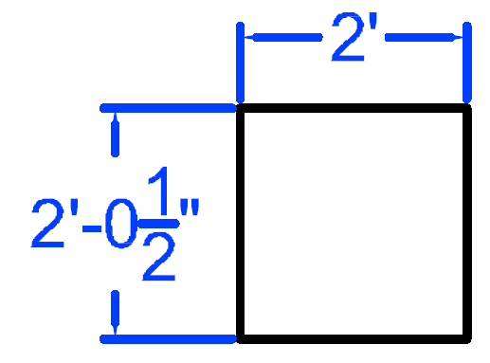
Peggy Ryan Williams Center
8
  Designed members indicated
    Chosen due to: Long spans,
    large tributary widths, high loadings
  Designed using spBeam
    Strength requirements
    Deflections checked per ACI 318-11 Table 9.5b
D
Introduction
Proposal
Structural Depth
  Gravity System
  Lateral System
  Bridge Truss
Architectural Breadth
Lighting Breadth
Conclusion
2
13
Column Line D
Column Line 2
Column Line 8
Column Line 13
Framing Plan
Girders/Beams

Slide 13
Peggy Ryan Williams Center
  Designed using spColumn
  Both axial loads from above & moments were applied
  Square section chosen
    Ease of construction
    Aid in future lateral system design
  All column sizes were increased to
    18”x 18” for constructability
Introduction
Proposal
Structural Depth
  Gravity System
  Lateral System
  Bridge Truss
Architectural Breadth
Lighting Breadth
Conclusion
Columns

Slide 14
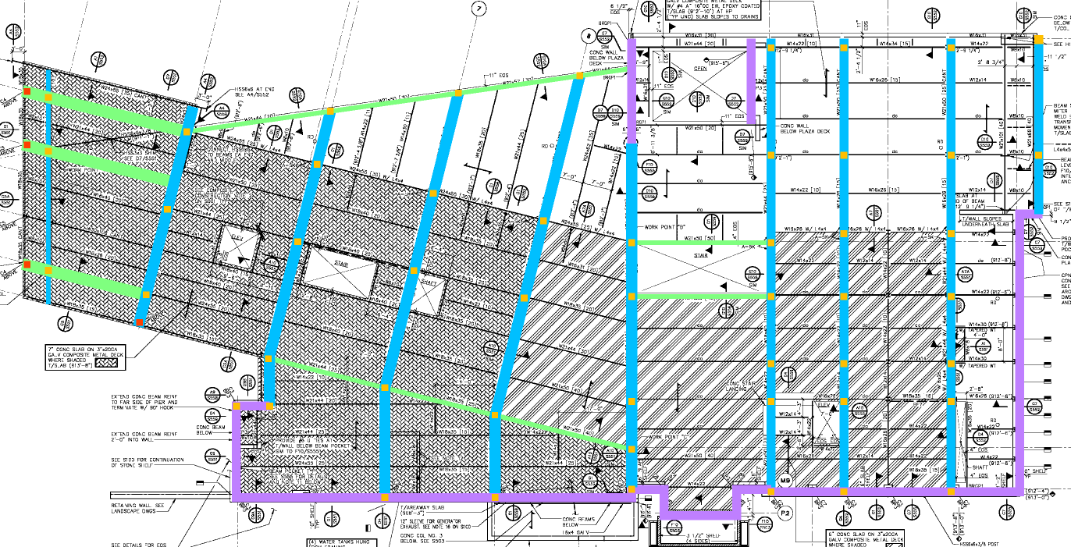
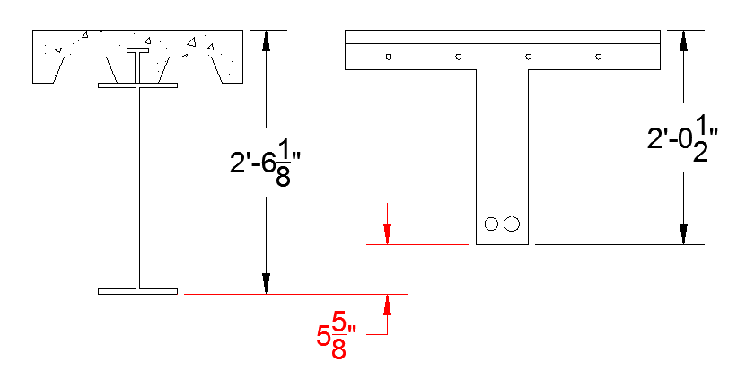
Peggy Ryan Williams Center
Introduction
Proposal
Structural Depth
  Gravity System
  Lateral System
  Bridge Truss
Architectural Breadth
Lighting Breadth
Conclusion
  Columns & girders were removed from original design
  Floor system depth decreased by 5-5/8”
    Larger floor-to-ceiling height
Summary
Existing
Redesign

Slide 15
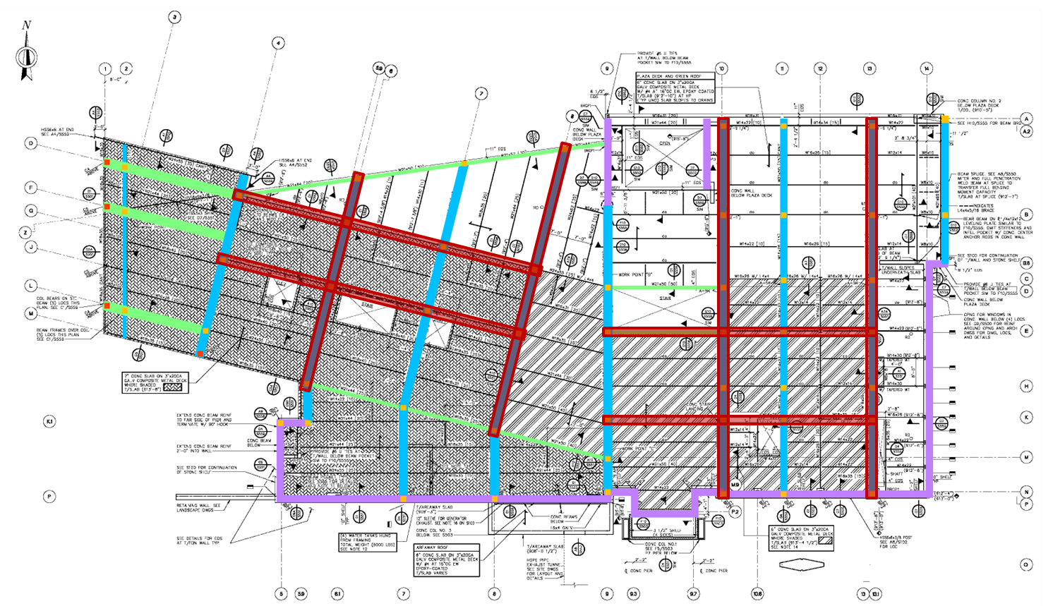
Peggy Ryan Williams Center
  Current lateral system
    Concentrically braced structural steel frames
    No longer the best option
  Gravity system may double as the lateral system
  Concrete moment frames in North-South and East-West directions
  4 concrete moment frames were considered in each direction
Introduction
Proposal
Structural Depth
  Gravity System
  Lateral System
  Bridge Truss
Architectural Breadth
Lighting Breadth
Conclusion
Lateral System Introduction

Slide 16
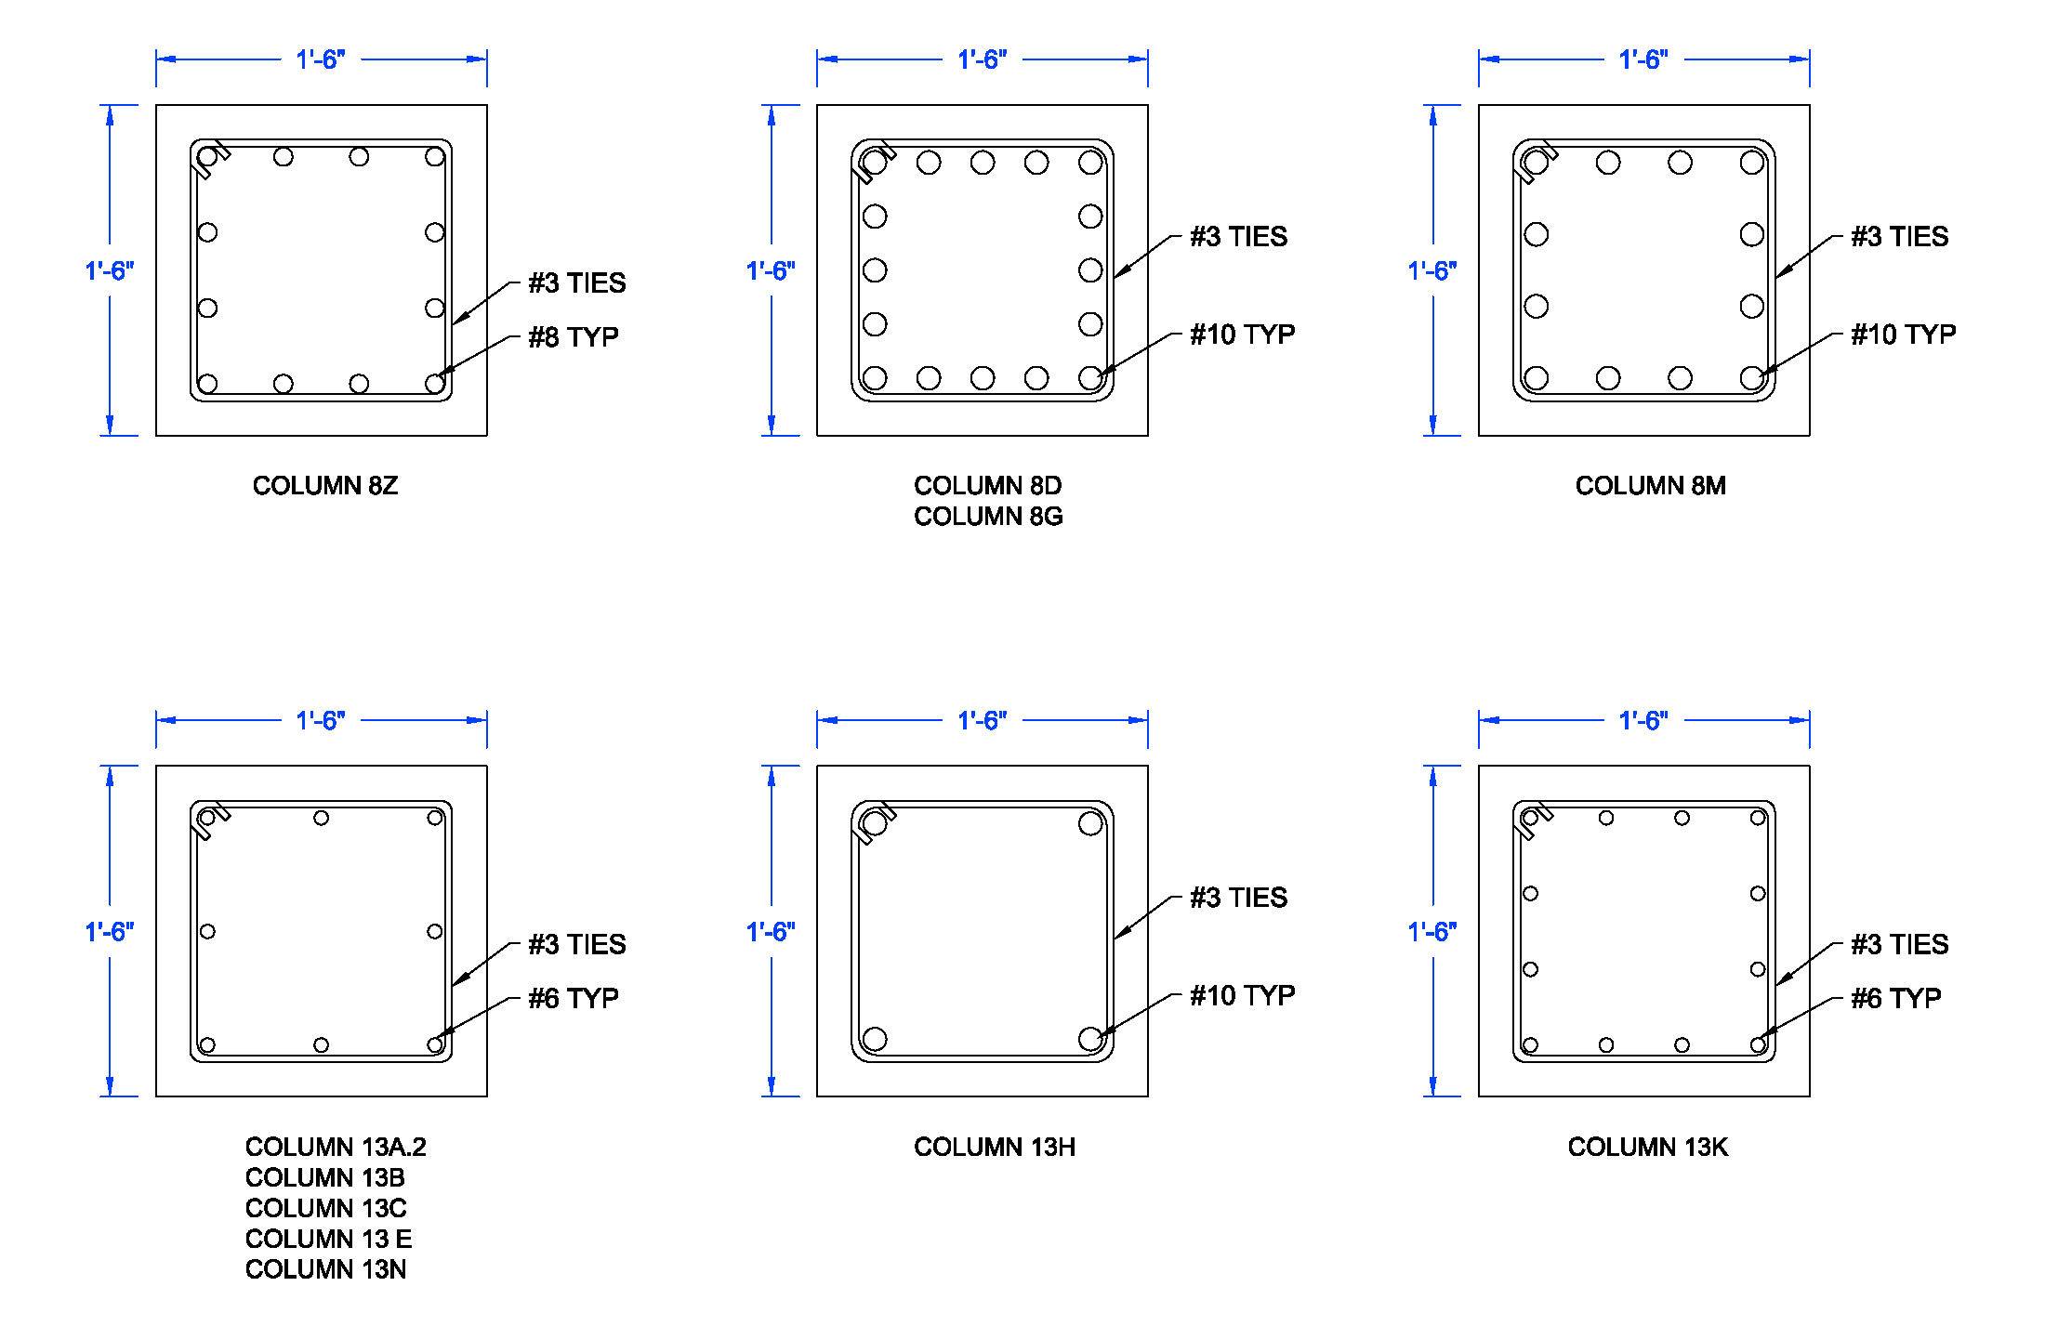
Peggy Ryan Williams Center
  Both wind and seismic forces were calculated per ASCE7-10
    Wind controlled
  Using spColumn, 18”x18” columns were designed
    Biaxial bending was considered
  Worst case girder and joist were checked for beam-column interaction
    Found to be adequate
Introduction
Proposal
Structural Depth
  Gravity System
  Lateral System
  Bridge Truss
Architectural Breadth
Lighting Breadth
Conclusion
Lateral System Analysis

Slide 17
Peggy Ryan Williams Center
Introduction
Proposal
Structural Depth
  Gravity System
  Lateral System
  Bridge Truss
Architectural Breadth
Lighting Breadth
Conclusion
  Analysis was done using 4 frames in both directions
    By adding frames the system will surely be adequate
  The gravity system of the building doubles as the lateral system
Summary

Slide 18
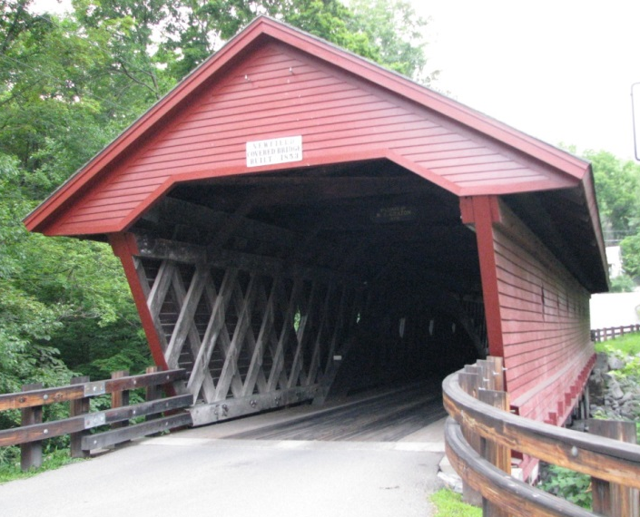
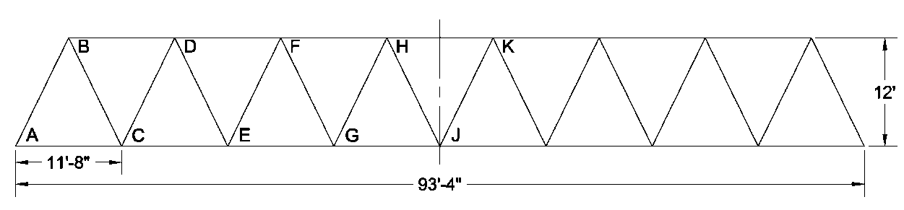
Peggy Ryan Williams Center
Introduction
Proposal
Structural Depth
  Gravity System
  Lateral System
  Bridge Truss
Architectural Breadth
Lighting Breadth
Conclusion
  Sketches were produced to determine which inspiration would be used in the redesign
    The covered bridge option was chosen
  Box truss design
  Move supports out to open up the space
  Warren Truss
Bridge Introduction

Slide 19
Peggy Ryan Williams Center
Introduction
Proposal
Structural Depth
  Gravity System
  Lateral System
  Bridge Truss
Architectural Breadth
Lighting Breadth
Conclusion
  Only gravity loads were considered for the side trusses
  Panel point loads were determined based on layout
  Controlling Load Combinations:
    1.2 D + 1.6 L + 0.5 S
    1.2 D + 1.6 S + L
Loads

Slide 20
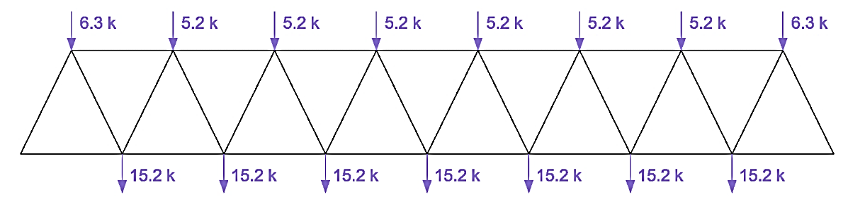
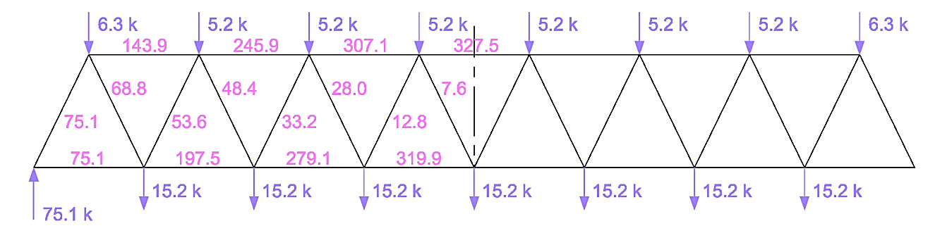
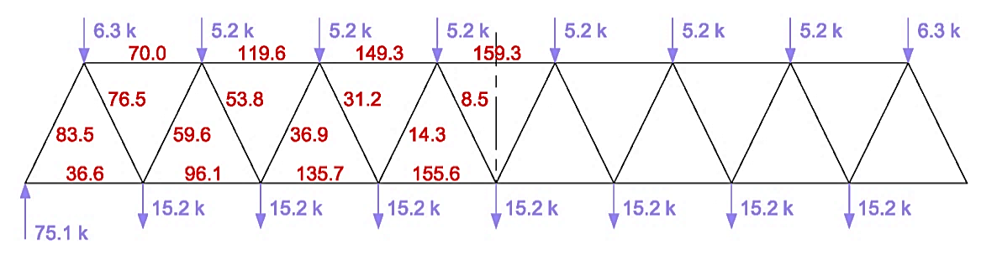
Peggy Ryan Williams Center
1.2 D + 1.6 L + 0.5 S
  Indexing Method
  Loading all panel points
    Produced worst case force in top chord, bottom chord, and far left diagonal
  Use of geometry to determine member forces
  Method of Joints to verify Indexing Method forces
    Indexing Method is an accurate method of analysis
Introduction
Proposal
Structural Depth
  Gravity System
  Lateral System
  Bridge Truss
Architectural Breadth
Lighting Breadth
Conclusion
Member Force Determination

Slide 21
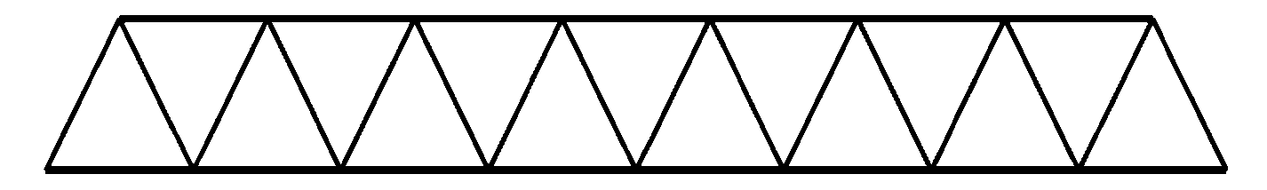
Peggy Ryan Williams Center
Introduction
Proposal
Structural Depth
  Gravity System
  Lateral System
  Bridge Truss
Architectural Breadth
Lighting Breadth
Conclusion
  Steel Manual Tables
    Table 4-4 for top chord and diagonal compression members
    Table 5-5 for bottom chord tension member
  Top Chord: HSS7x7x¼
  Bottom Chord: HSS7x7x¼
  Diagonals: HSS4x4x½
Member Design

Slide 22

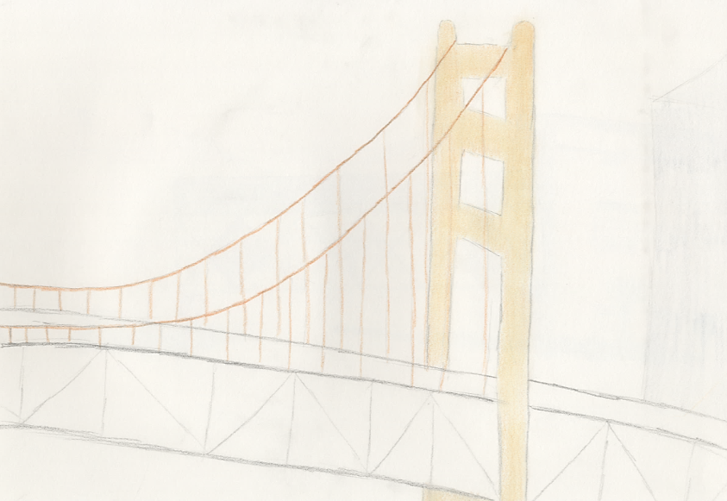
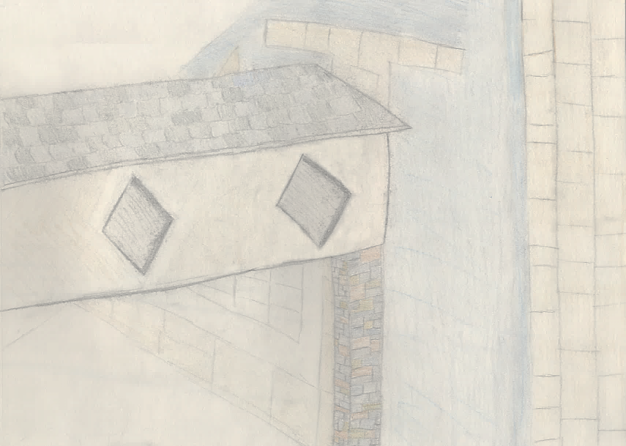
Peggy Ryan Williams Center
Introduction
Proposal
Structural Depth
  Gravity System
  Lateral System
  Bridge Truss
Architectural Breadth
Lighting Breadth
Conclusion
The Newfield Bridge
The Golden Gate Bridge

Slide 23
Peggy Ryan Williams Center
Introduction
Proposal
Structural Depth
  Gravity System
  Lateral System
  Bridge Truss
Architectural Breadth
Lighting Breadth
Conclusion
The Newfield Bridge
The Golden Gate Bridge

Slide 24
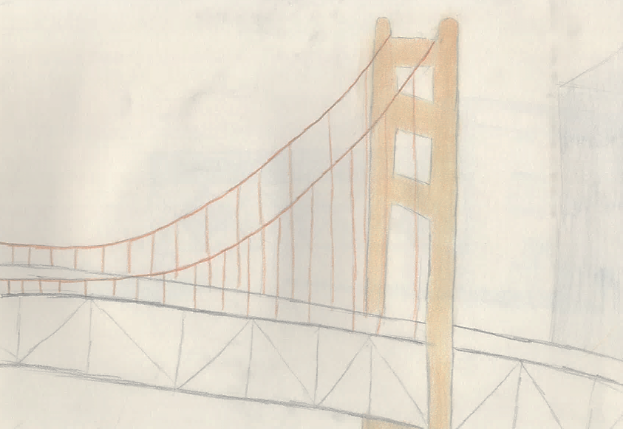
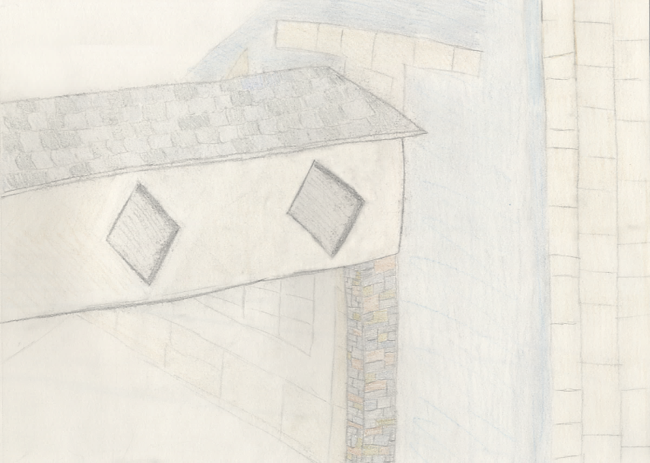
Peggy Ryan Williams Center
Introduction
Proposal
Structural Depth
  Gravity System
  Lateral System
  Bridge Truss
Architectural Breadth
Lighting Breadth
Conclusion
Public domain
The Newfield Bridge
The Golden Gate Bridge

Slide 25
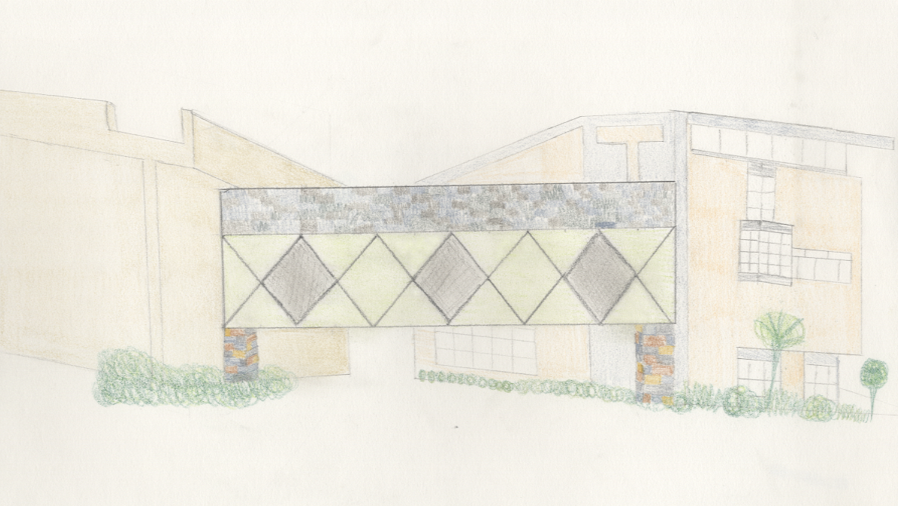
Peggy Ryan Williams Center
The Newfield Bridge
Introduction
Proposal
Structural Depth
  Gravity System
  Lateral System
  Bridge Truss
Architectural Breadth
Lighting Breadth
Conclusion
Chosen Inspiration

Slide 26
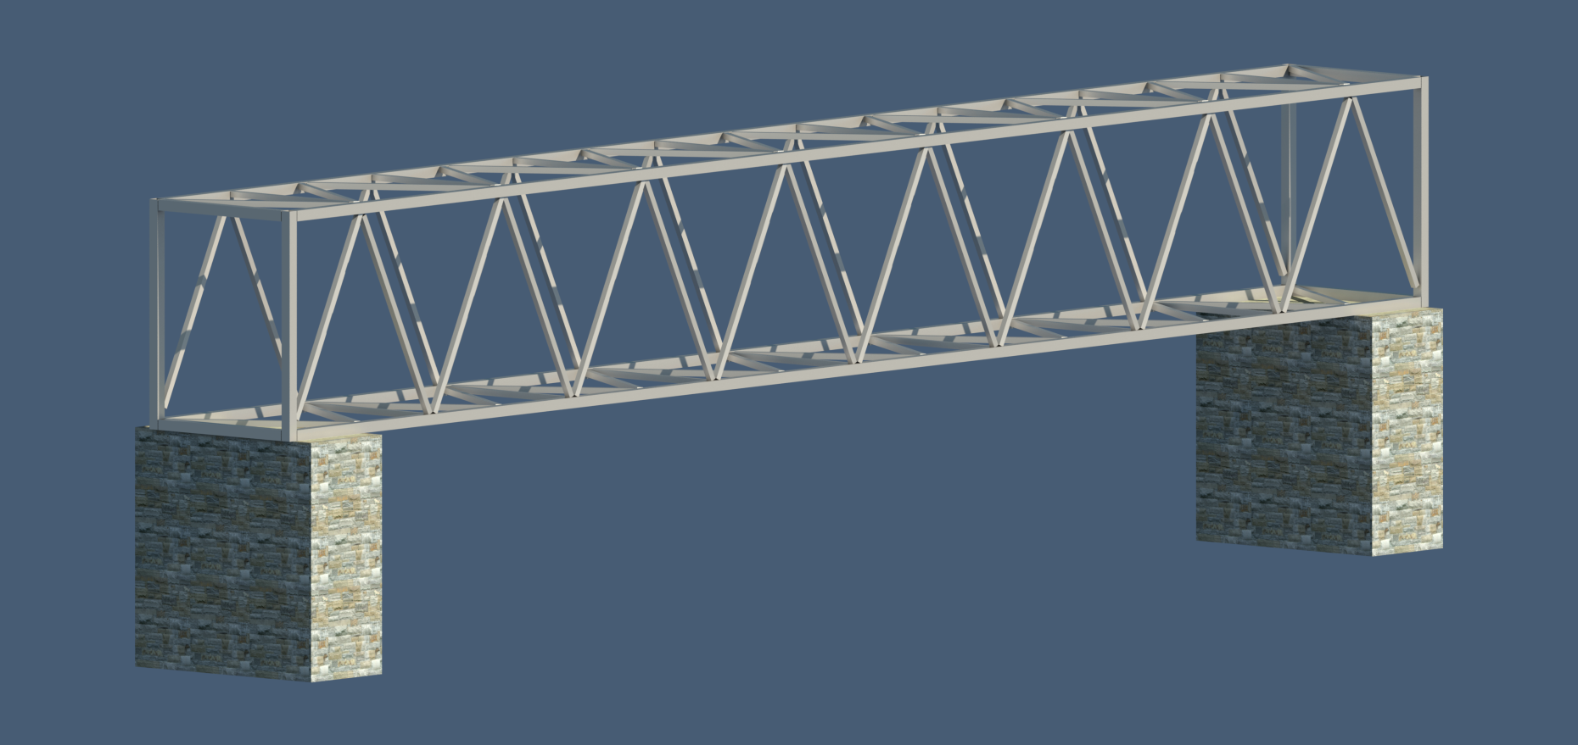
Peggy Ryan Williams Center
Truss Design
Introduction
Proposal
Structural Depth
  Gravity System
  Lateral System
  Bridge Truss
Architectural Breadth
Lighting Breadth
Conclusion
Redesign

Slide 27


Peggy Ryan Williams Center
Façade Inspiration
Introduction
Proposal
Structural Depth
  Gravity System
  Lateral System
  Bridge Truss
Architectural Breadth
Lighting Breadth
Conclusion
Photo provided courtesy of ebayink
Redesign

Slide 28
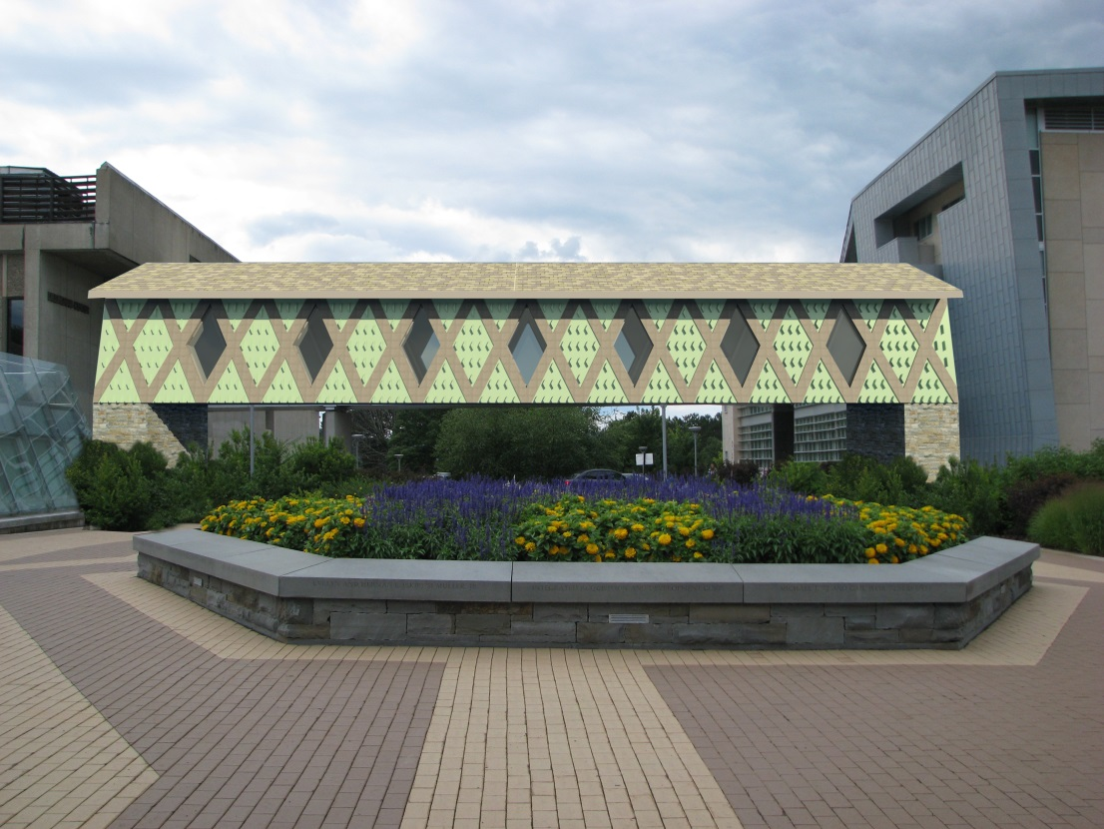
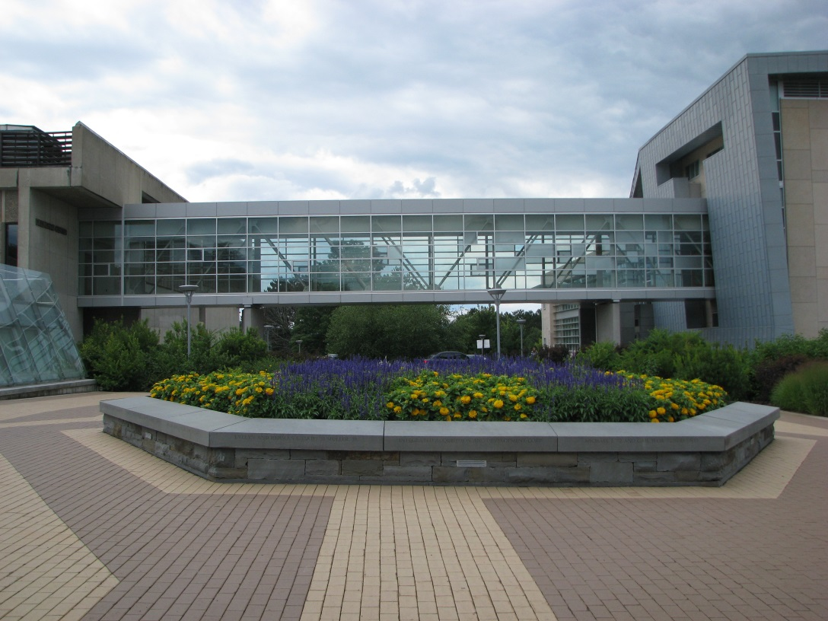
Peggy Ryan Williams Center
Redesigned Bridge Façade
Existing Bridge Façade
Introduction
Proposal
Structural Depth
  Gravity System
  Lateral System
  Bridge Truss
Architectural Breadth
Lighting Breadth
Conclusion
Façade Comparison

Slide 29
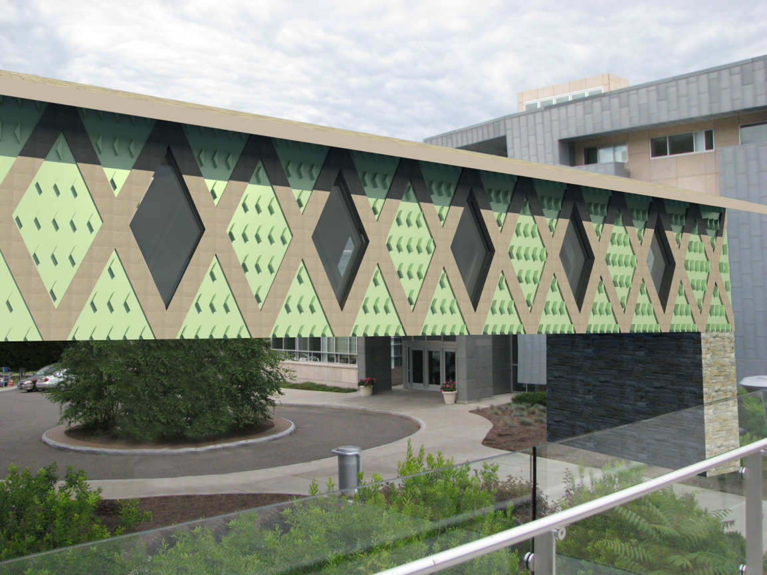

Peggy Ryan Williams Center
Redesigned Bridge Façade
Existing Bridge Façade
Introduction
Proposal
Structural Depth
  Gravity System
  Lateral System
  Bridge Truss
Architectural Breadth
Lighting Breadth
Conclusion
Façade Comparison

Slide 30
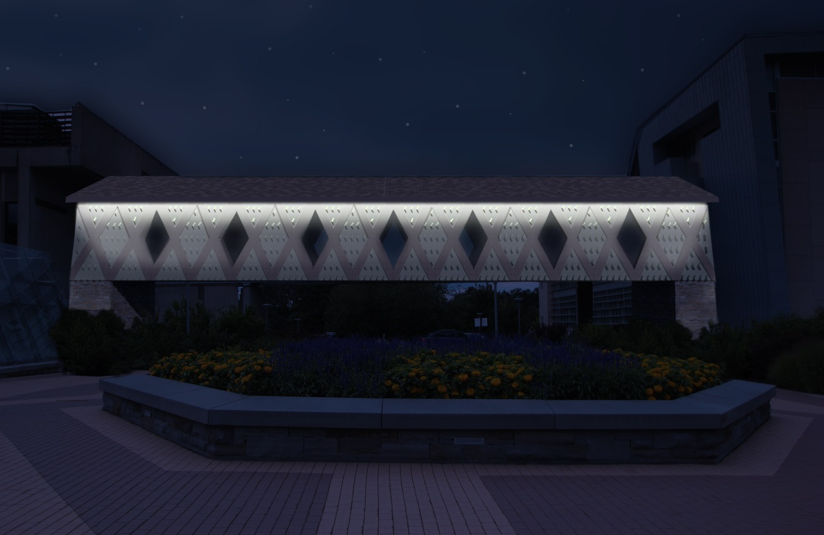
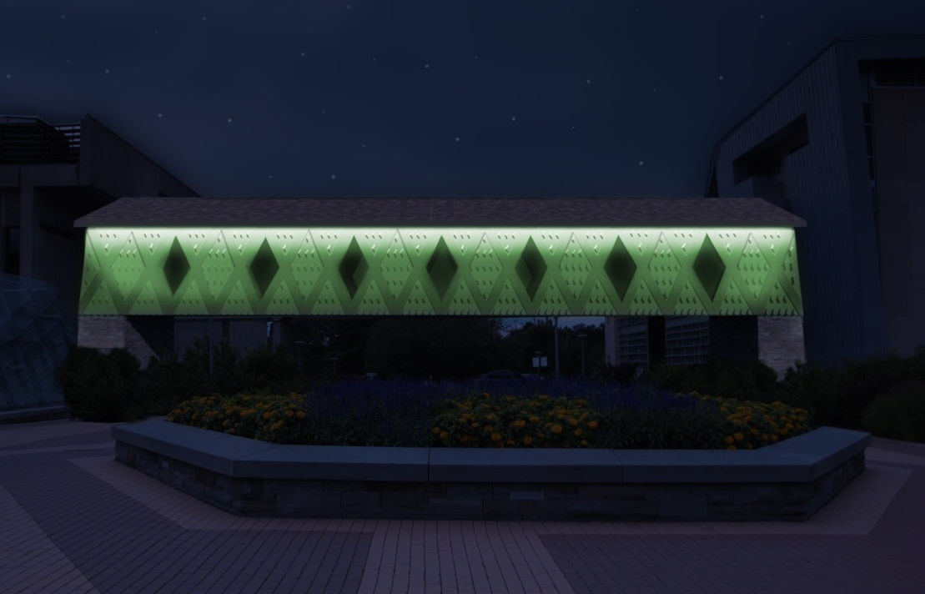
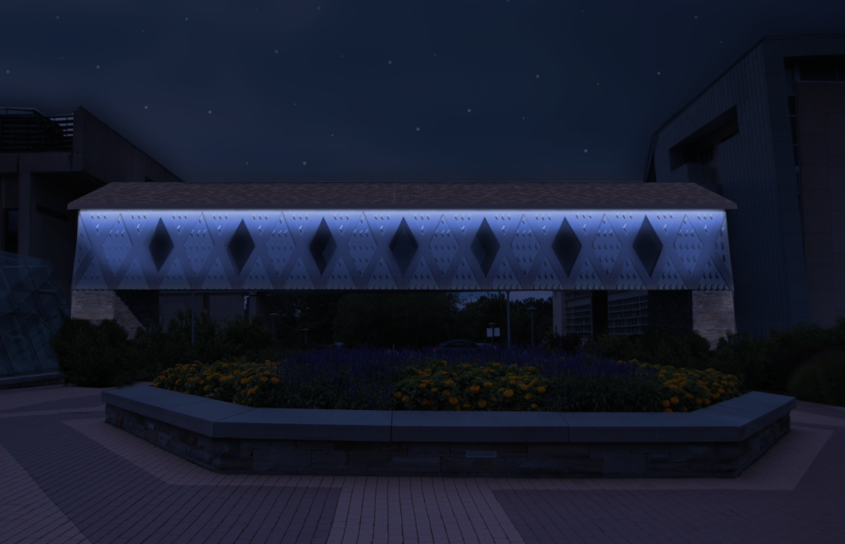
Peggy Ryan Williams Center
Introduction
Proposal
Structural Depth
  Gravity System
  Lateral System
  Bridge Truss
Architectural Breadth
Lighting Breadth
Conclusion
Lighting Breadth

Slide 31
Peggy Ryan Williams Center
Goals| Design a one way concrete slab system while:
          Minimizing floor system depth
          Minimize architectural impact
Conclusion| Designed a one way concrete slab system while:
          Floor system depth decreased by 5-⅝ inches
          Decreased number of columns and girders
          Gravity system adequate for Lateral Loads
Goals| After considering two redesign options:
          Determine which option to move forward with
          Design one side truss of the bridge
Conclusion| Considered two redesign options:
          Chose the covered bridge option
          Designed side truss using the Indexing Method
Introduction
Proposal
Structural Depth
  Gravity System
  Lateral System
  Bridge Truss
Architectural Breadth
Lighting Breadth
Conclusion
Building
Bridge

Slide 32
Peggy Ryan Williams Center
Goals| Design a one way concrete slab system while:
          Minimizing floor system depth
          Minimize architectural impact
Conclusion| Designed a one way concrete slab system while:
          Floor system depth decreased by 5-⅝ inches
          Decreased number of columns and girders
          Gravity system adequate for Lateral Loads
Goals| After considering two redesign options:
          Determine which option to move forward with
          Design one side truss of the bridge
Conclusion| Considered two redesign options:
          Chose the covered bridge option
          Designed side truss using the Indexing Method
Introduction
Proposal
Structural Depth
  Gravity System
  Lateral System
  Bridge Truss
Architectural Breadth
Lighting Breadth
Conclusion
Building
Bridge

Slide 33
Peggy Ryan Williams Center
Ryan-Biggs Associates
Holt Architects
Entire AE Faculty
Dr. Thomas Boothby
Professor M. Kevin Parfitt
Fellow AE Students
Family and Friends
Introduction
Proposal
Structural Depth
  Gravity System
  Lateral System
  Bridge Truss
Architectural Breadth
Lighting Breadth
Conclusion
Acknowledgements

Slide 34


Peggy Ryan Williams Center
AE Senior Thesis
April 14, 2014
Angela Mincemoyer
Structural Option
Advisor | Dr. Boothby
Photo provided courtesy of Holt Architects
Questions

